Slide 1

DIGITAL Twins
In Machine Learning
Lareb Amir (21K-4173)
Maham Sabir (21K- 4216)

Slide 2
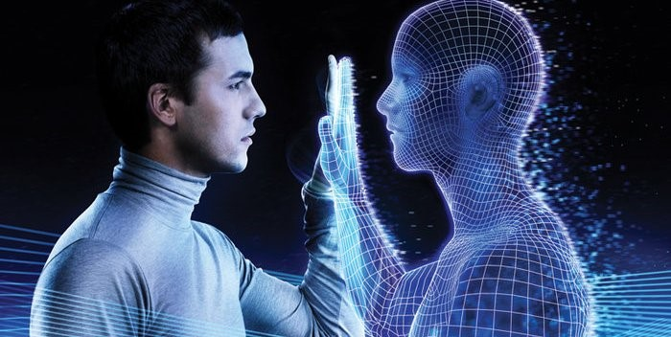
What is Digital Twin
Nunc viverra imperdiet enim. Fusce est. Vivamus a tellus.
A DIGITAL TWIN is a Digital Version Of a Physical Object process or service.
‘A digital twin is a virtual model that is created to accurately reflect an existing physical object.
The physical object is fitted with sensors that produce data about different aspects of the object's performance.
The developers who create digital twins ensure that the virtual computer model can receive feedback from sensors that gather data from the real world version. This lets the digital version mimic and simulate what is happening with the original version in real time

Slide 3
The concept was divided into types later. - DIGITAL TWIN PROTOTYPE (DTP) - DIGITAL TWIN INSTANCE (DTI), - DIGITAL TWIN AGGREGATE (DTA). The DTP consists of the designs, analyses, and processes to realize a physical product. The DTP exists before there is a physical product. The DTI is the digital twin of each individual instance of the product once it is manufactured. The DTA is the aggregation of DTIs whose data and information can be used for interrogation about the physical product, prognostics, and learning. The specific information contained in the digital twins is driven by use cases. The digital twin is a logical construct, meaning that the actual data and information may be contained in other applications.
Nunc viverra imperdiet enim. Fusce est. Vivamus a tellus.

Slide 4



How Does Digital Twin Technology Work?
Historical performance data of individual machines, overall processes, and specific systems.
PAST DATA
Real-time data from equipment sensors, outputs from manufacturing platforms and systems, and outputs from systems throughout the distribution chain. It can also include outputs from systems in other business units, including customer service and purchasing.
PRESENT DATA
Machine Learning as well as inputs from engineers.
FUTURE DATA

Slide 5
Technologies For DITITAL TWINS
IoT
INTERNET OF THINGS
IoT sensors enable constant data transmission, which is used to create a digital duplicate of physical object
CLOUD
CLOUD COMPUTING
Cloud computing allows to store gained data in the virtual cloud and easily access them from any location.
EXTENDED REALITY
Due to its visualization capabilities, XR allows to digitally model physical objects
XR
AI
ARTIFICAL INTELLIGENCE
As an advanced analytical tool, AI automatically analyze obtained data, provide valuable insights and made predictions
Data from the original asset is used to built and improve DIGITAL TWIN.

Slide 6
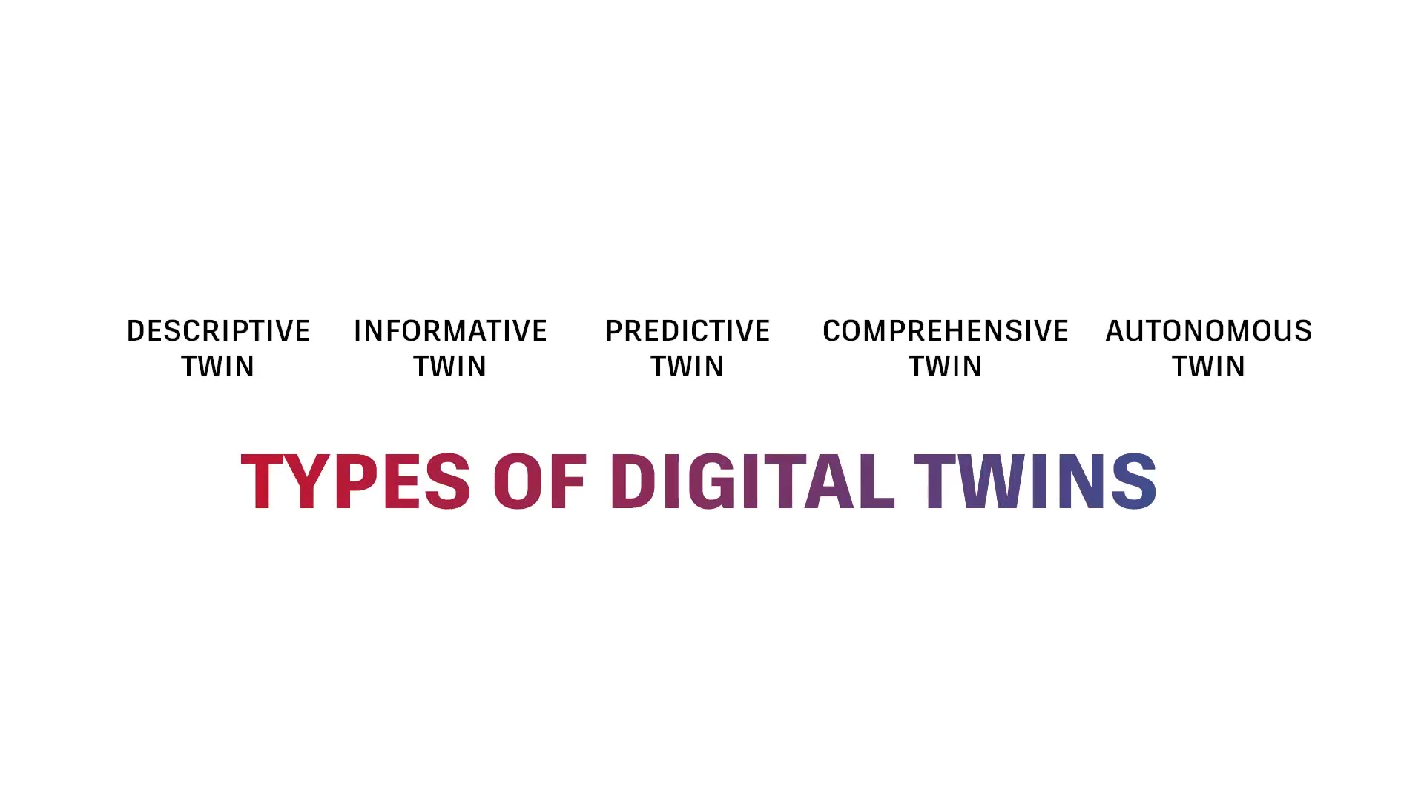

Slide 7
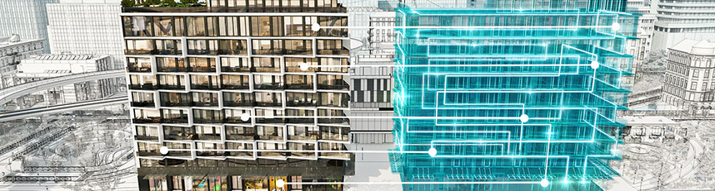

Descriptive Twin
A DESCRIPTIVE Twin is a live, editable version of design and construction data.

Slide 8
Informative Twin
A INFORMATIVE Twin manage operational and sensory data.
As data is added twin become richer and richer and strongly linked to its physical counter-part.

Slide 9
COMPREHENSIVE Twin
COMPREHENSIVE Twin simulates future Senecios. It consider WHAT-IF questions.

Slide 10
Autonomous Twin
In future Twin will become AUTONOMOUS, able to learn and act on behalf of users.

Slide 11

Conclusion
A Digital Twin is a Simulation?
Not exactly. A digital twin starts as a simulation, but the difference between a digital simulation and a digital twin is real-time updates.
With a simulation, engineers can run tests and conduct assessments on a simulated version of a physical asset. The simulation is static, however. In other words, it doesn’t keep pace with the physical asset unless the engineer inputs new parameters into the simulation.
A digital twin, on the other hand, receives real-time updates from the physical asset, process, or system. Therefore, the tests, assessments, and analysis work conducted by engineers are based on real-world conditions. As the state of the digital twin dynamically changes as it receives new data from the physical world, it matures, producing outputs that are more accurate and valuable.

